Slide 1
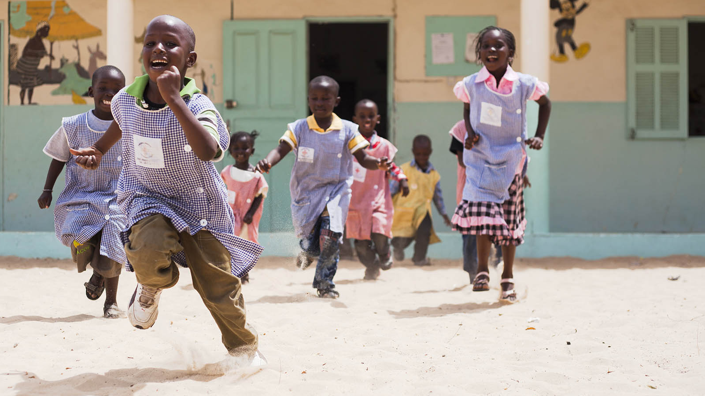
ALL LIVES HAVE EQUAL VALUE
Financial Services for the Poor
Rosita Najmi, Washington, DC
September 21, 2015

Slide 2
BMGF Global Reach and Presence
US $40 B
Asset Trust Endowment
1,200
2012 active grantees
Europe and
Middle East Office
Seattle
China
Washington, D.C.
US $3.6B
2013 grant payments
India
Nigeria
Ethiopia
1,100
2012 employees worldwide
South Africa
Trustees
Bill & Melinda Gates,
Warren Buffett

Slide 3
GLOBAL HEALTH
Discovery & Translational Services
Enteric and Diarrheal Diseases
HIV
Malaria
Neglected Infectious Diseases
Pneumonia
Tuberculosis
GLOBAL DEVELOPMENT
Agricultural Development
Emergency Response
Family Planning
Financial Services for the Poor
Global Libraries
Integrated Delivery
Maternal, Newborn & Child Health
Nutrition
Polio
Vaccine Delivery
Water, Sanitation & Hygiene
Reinvent the Toilet
U.S. PROGRAM
College-Ready Education
Postsecondary Success
Washington State

Slide 4
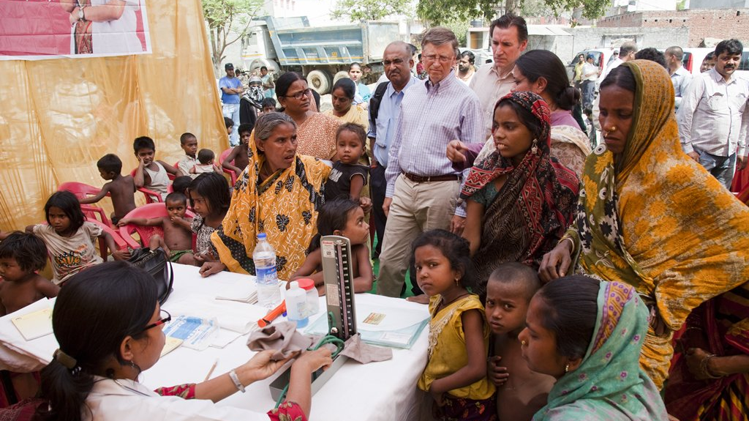
The Gates Foundation believes that
EVERYONE BENEFITS
from an economy that includes everyone.
Yet today
BILLIONS ARE EXCLUDED
from a formal economy.
© Bill & Melinda Gates Foundation |
4

Slide 5
Why Digital?
© Bill & Melinda Gates Foundation |
5

Slide 6
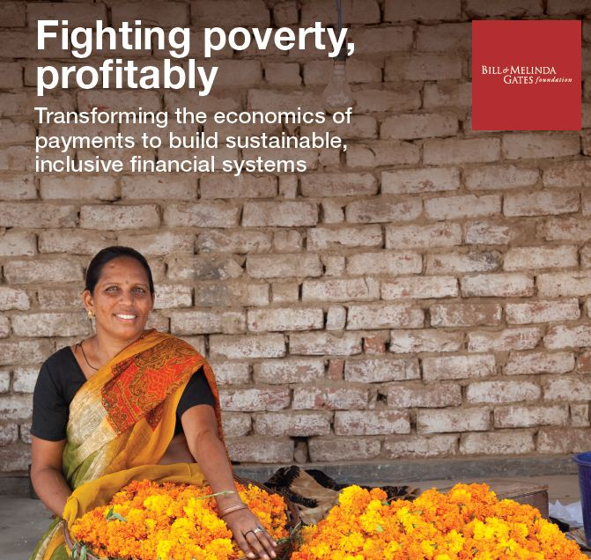
Key observations
The economics of traditional transactions don’t work for providers or the poor.
Economic barriers include customer acquisition, account maintenance costs, and variable returns.
Market coordination failures produce fragmented networks that increase costs.
Information asymmetries inhibit adoption and create risk, leading to inadequate products & dormancy.
Regulatory & policy barriers increase the cost & uncertainty for serving the poor.
Technology is necessary but not sufficient.
The economics and other barriers require a new, digital financial system that is inclusive & sustainable
© Bill & Melinda Gates Foundation |
6

Slide 7
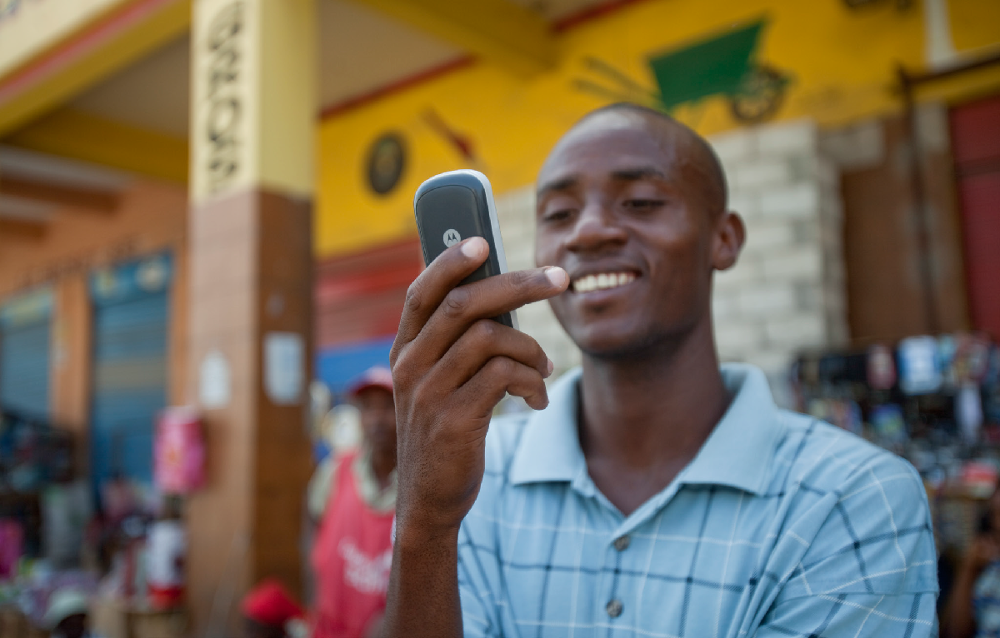
Our Objectives
To help poor people move out of poverty and stay out of poverty, we seek to:
Generate economy-wide efficiencies by digitally connecting all people to the financial system
Reduce the amount of time and money that poor people spend to conduct financial transactions
Increase poor people’s capacity to smooth cash flows, weather financial shocks and capture income-generating opportunities
Focus countries: Bangladesh, India, Indonesia, Kenya, Nigeria, Pakistan, Tanzania, Uganda
© Bill & Melinda Gates Foundation |
7

Slide 8
Stages of Market Development
Kenya
Tanzania
Uganda
4
High Impact Digital Financial Services
Bangladesh
3
Pakistan
Digital Payment Ecosystem
Poor people adopt and use digital to move out of poverty and stay out of poverty
Nigeria
India
Poor people get money, spend money, and conduct a majority of financial transactions digitally, including proximity payments .
Indonesia
2
Digital Payment Platform
1
Enabling Environment
Poor people adopt and use low-cost digital systems for P2P and basic transfers.
Basic Connectivity
Enabling regulations that support poor people to open accounts and providers to outsource distribution, and to protect users
Critical mass of mobile coverage and penetration amongst rural poor
© Bill & Melinda Gates Foundation |
8

Slide 9
Highlights
Enabling Environment
Level One Project
Ecosystems and Services
Research and Emerging Technology
Brookings Institute Financial Digital Inclusion Project
Taxation on Mobile Money
De-Risking Cross Border Flows
Payments/Nonbank Licenses

Slide 10
Highlights
Enabling Environment
Brookings Institute Financial Digital Inclusion Project
Level One Project
Taxation on Mobile Money
Ecosystems and Services
De-Risking Cross Border Flows
Research and Emerging Technology
Payments/Nonbank Licenses
Rating and ranking of 21 countries across four dimensions of financial inclusion: country commitment, mobile capacity, regulatory environment, and adoption of basic, traditional and digital financial services, including payments and savings.
Investigation of impact of taxation on mobile money in Tanzania and Pakistan.
Studies by G20, World Bank, and Center for Global Development re impact of AML-CTF and KYC requirements on remittances, correspondent banking, and humanitarian finance.
India approved 11 applicants: MNOs, large conglomerates, payments company, India Post, pharmaceutical company, and several distribution companies.
14

Slide 11
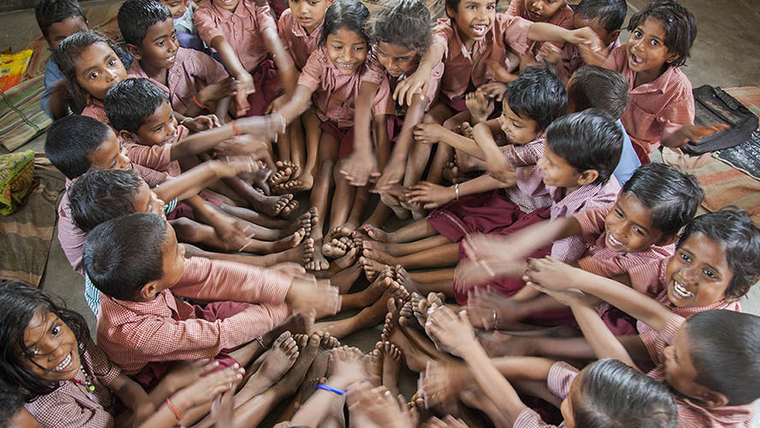
Thank you & Questions
© Bill & Melinda Gates Foundation |
16

